Slide 1
Mini Project Team 1
1. Abhishek Dengi:01FE20BAR046
2. Nakul Sharathkumar: 01FE20BAR027
3. Nitin Mahadev Ghorpade: 01FE20BAR038
4. Patanjali Joshi: 01FE20BAR036
5. Samarth Vengurlekar: 01FE20BAR006
Department Of Automation and Robotics, 2022-2023

Slide 2
The Problem
Automated Domestic Irrigation System
Automated Domestic Irrigation System
Inconvenience: Watering plants manually can be time-consuming and inconvenient, particularly for people who are busy or away from home frequently.
Water waste:
Manually watering plants can sometimes result in water waste due to overspray or runoff.
Inconsistent watering: It can be difficult to maintain a consistent watering schedule manually, which can lead to over or under watering of plants
Plant health: Inconsistent watering or over/under watering can lead to poor plant health.

Slide 3

Automated Domestic Irrigation System
Our Solution
Automated Domestic Irrigation System
A fail-proof, easy to operate and resource-efficient solution to regulate the soil moisture level of the garden and maintain the general health of plants.

Slide 4
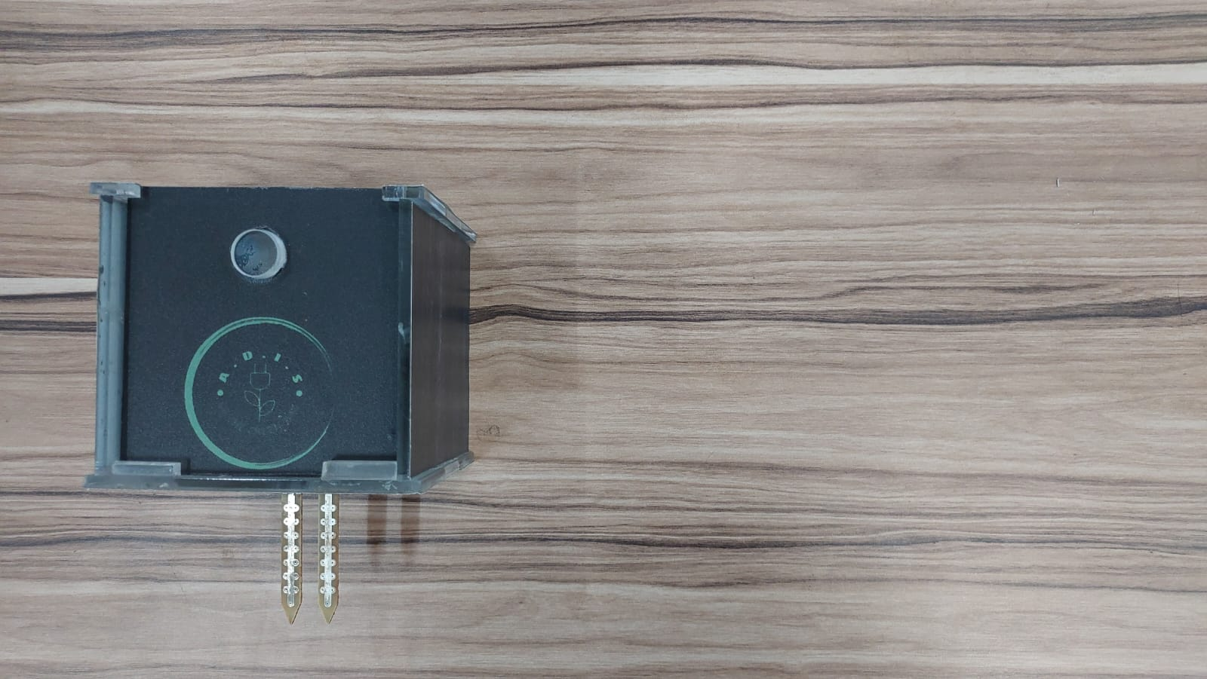
How Does It Work??
Sensor Unit:
The sensor unit measures the real-time soil moisture level and updates it in the database.

Slide 5


How Does It Work??
Web Interface:
Displays the current soil moisture level and valve status to the user.

Slide 6
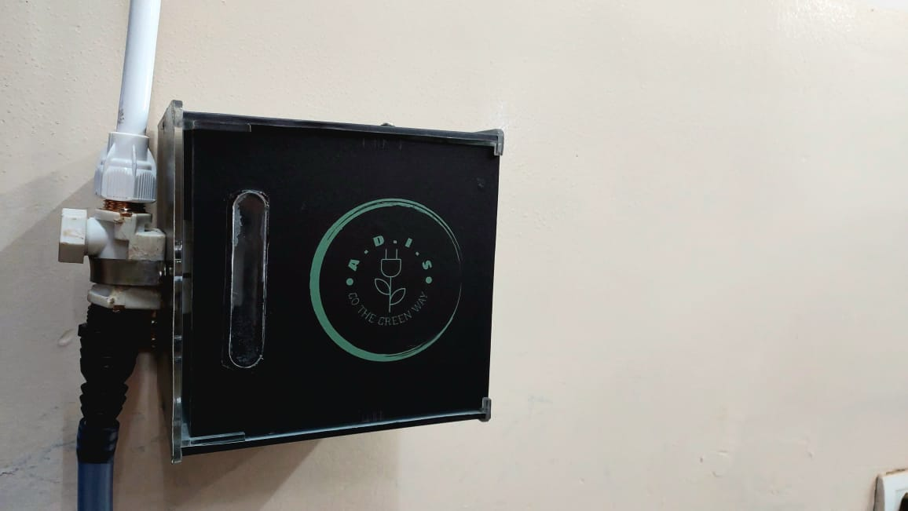
How Does It Work??
Control Unit:
The control unit receives moisture data from the database and actuates the valve accordingly.

Slide 7
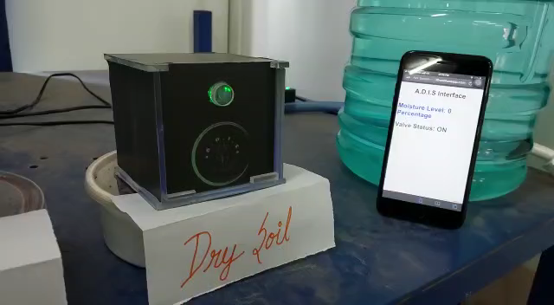
How Does It Work??
Demonstration of working prototype

Slide 8
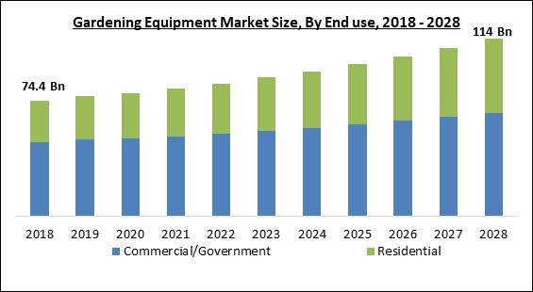
Market Analysis
Global Gardening Equipment Market size
$114 5.0%
billion by 2028 Expected CAGR
Indian Gardening Home Retail Sector Market size
₹ 3,538 ₹ 5,807 10.4%
billion in 2020 billion by 2025 Expected CAGR
Source:
Home and Garden Retailing in India - Sector Overview, Market Size and Forecast to 2025 (researchandmarkets.com)
Global Gardening Equipment Market Size, Share & Industry Trends Analysis Report By End use (Commercial/Government and Residential), By Product, By Sales Channel, By Regional Outlook and Forecast, 2022-2028 (researchandmarkets.com)

Slide 9
Price Estimation
₹ 2318* ₹ 600 ₹ 200 ₹ 3118
Material Cost Labour Cost Overhead Costs Total Manufacturing Cost
44% ~₹ 1381 ~₹ 4499
Profit Margin Profit Gain Final Price
*Refer Bill of Materials from Project Report

Slide 10
Conclusion
The domestic irrigation system will improve the efficiency of watering the garden and reduce water usage. The system would consist of a network of sprinklers or drip lines, controlled by the central control unit, to efficiently distribute water to plants and lawns. The sensor-based irrigation system will also reduce the amount of time and effort required in maintaining the garden. Overall, the domestic irrigation system project would help improve the sustainability and aesthetic of the community.

